Slide 1
House Prices
Ivan Alexeev

Slide 2
Prediction house prices
What aspects affect the price of housing?
What price should I sell the house for?

Slide 3
Information about data
The Ames Housing dataset was compiled by Dean De Cock for use in data science education. It's an incredible alternative for data scientists looking for a modernized and expanded version of the often cited Boston Housing dataset.
Unprepared data contains 80 columns
Prepared data contains 277 columns

Slide 4
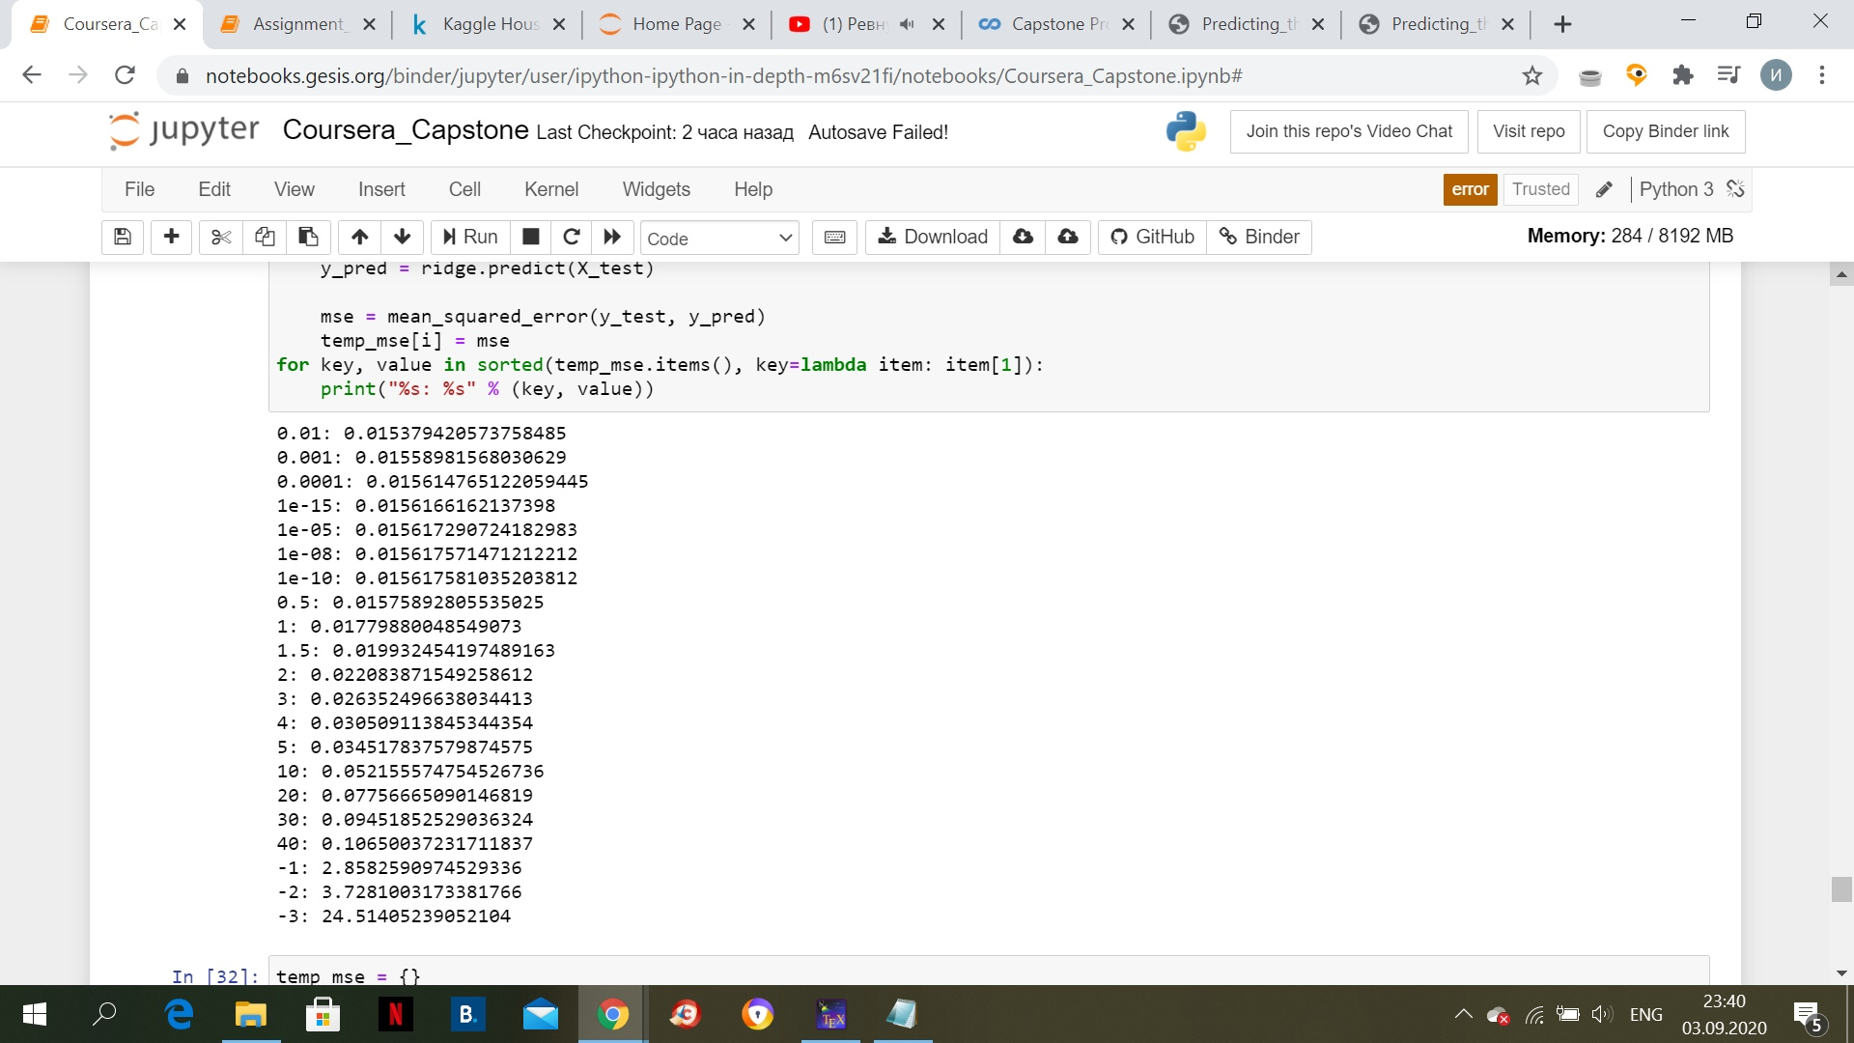
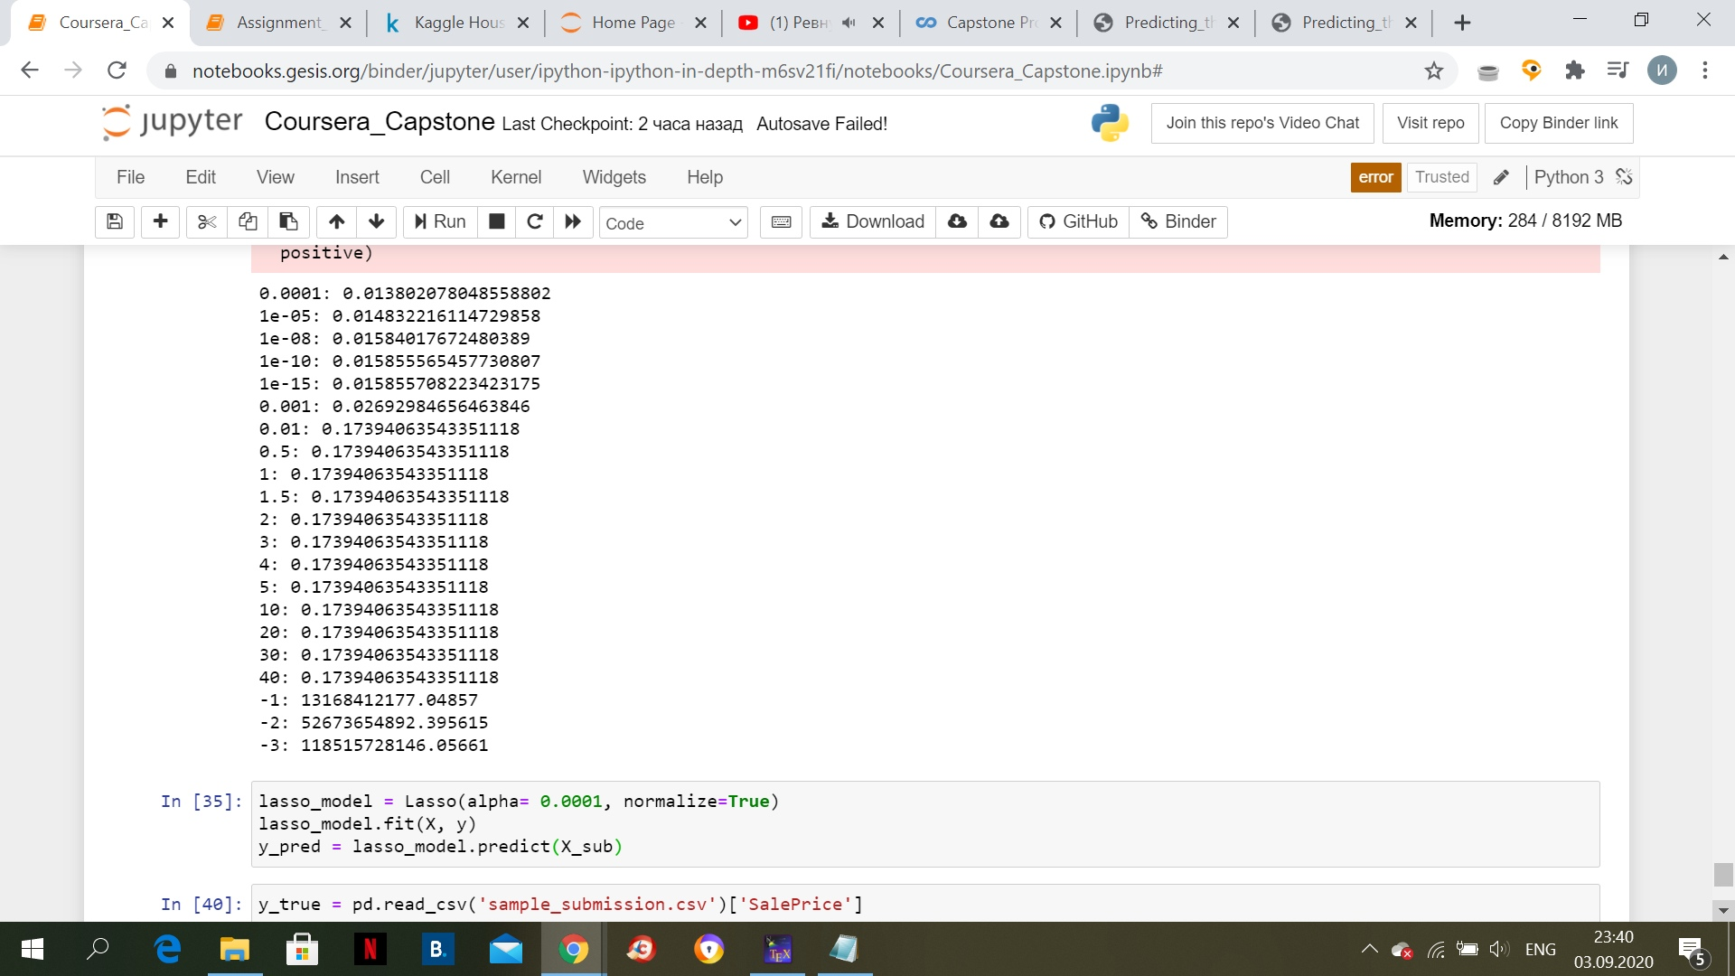
Search for the optimal approximation

